Slide 1

Optical Braille Translation
⠕⠏⠞⠊⠉⠁⠇ ⠃⠗⠁⠊⠇⠇⠑ ⠞⠗⠁⠝⠎⠇⠁⠞⠊⠕⠝

Slide 2
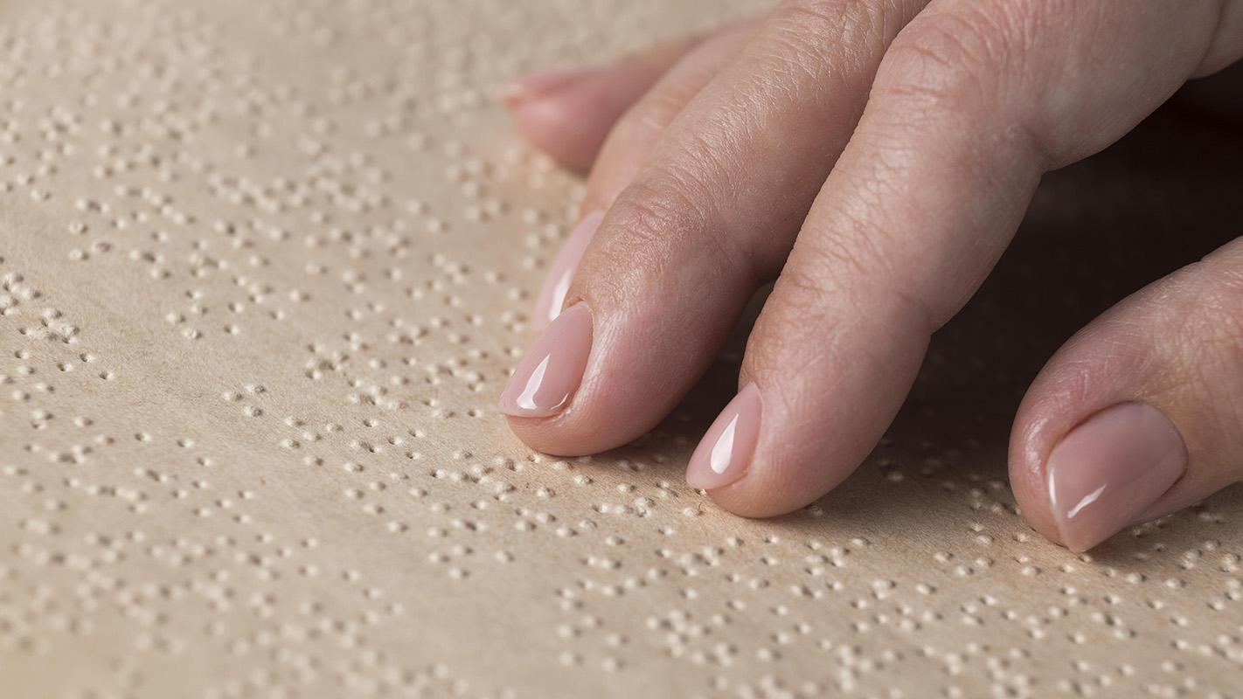

Problem
⠏⠗⠕⠃⠇⠑⠍
⠎⠕⠇⠥⠞⠊⠕⠝
Solution
Isolation for Braille users due to limited interaction with non-Braille users.
Create a system for easy access to Braille content for everyone.

Slide 3
Outlines
Introduction
Preprocessing
Detection
Dot Detection using Hough circle transform
Symbol Detection using white spaces
Recognition
Grid formation for character analysis
Convolutional Neural Network (CNN)
Translation & Text Correction
Text to Speech
GUI
Results & Future work

Slide 4

Braille Symbol
1
2
3
4
5
6
A Braille page is either one sided or double sided

Slide 5
Braille alphabet
Grade 1
A | B | C | D | E | F | G | H | I
J | K | L | M | N | O | P | Q | R
S | T | U | V | W | X | Y | Z

Slide 6
Braille alphabet
Grade 1
1 | 2 | 3 | 4 | 5 | 6 | 7 | 8 | 9
0 | K | L | M | N | O | P | Q | R
S | T | U | V | W | X | Y | Z

Slide 7
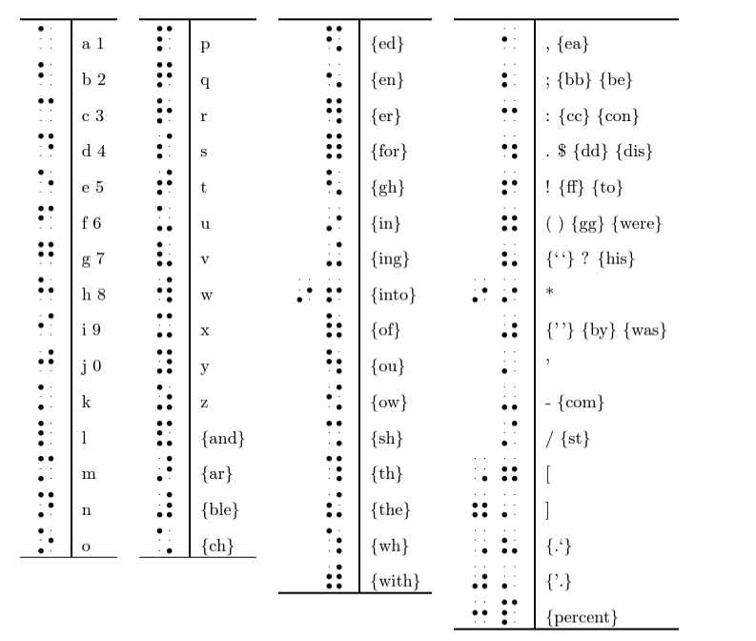
Grade 2 English Braille

Slide 8

Input Image
Printing
INDEX BRAILLE Everest-D V5
23cm x 33cm
Scanning
Flatbed
Grayscale
JPG, PNG
Resolution (DPI): 100

Slide 9
Preprocessing
⠏⠗⠑⠏⠗⠕⠉⠑⠎⠎⠊⠝⠛

Slide 10
Sample input 0
We utilized a free online software tool that converts text to Braille characters
Input to the software tool
Output of the software tool

Slide 11
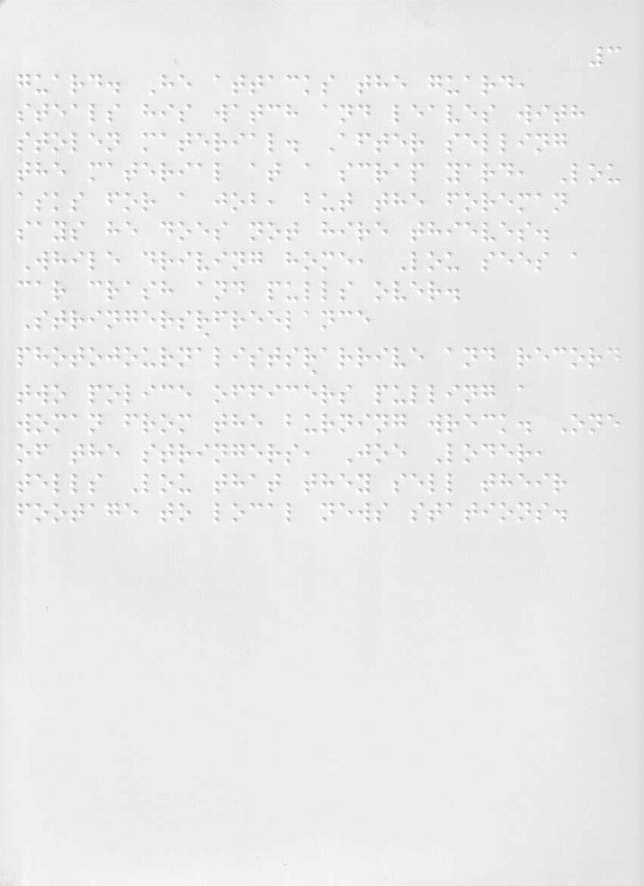
Sample input 1
We scanned optimal pages at 100 DPI Scanner noise is the only noise presented in this sample

Slide 12
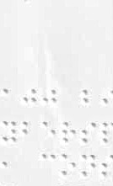
Sample input 2
Paper corruption

Slide 13

Sample input 3
Dusty paper

Slide 14

Sample input 4
Low content page

Slide 15
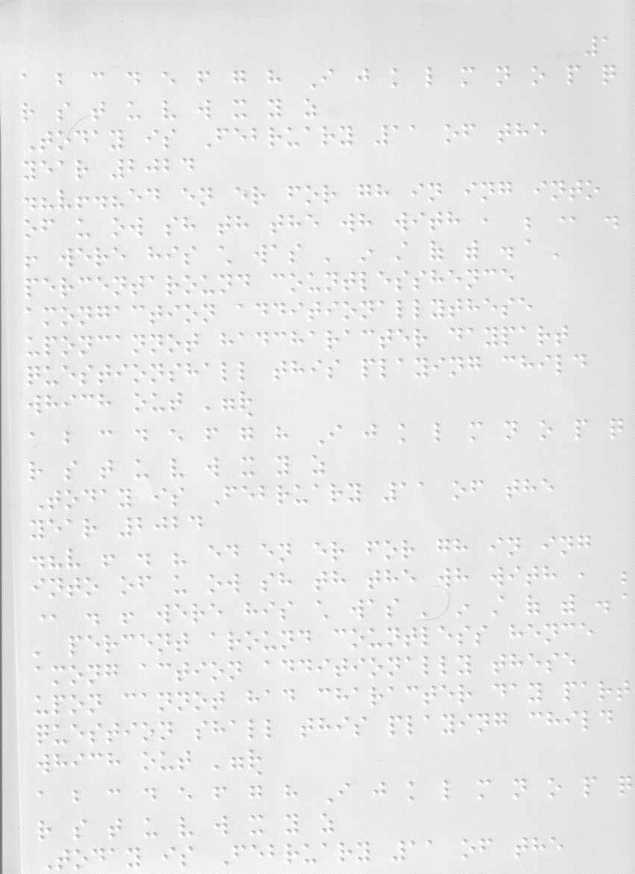
Sample input 5
Rotated paper

Slide 16
⠏⠗⠕⠃⠇⠑⠍
⠎⠕⠇⠥⠞⠊⠕⠝
Problem
Solution
Various sources of Errors
Filters

Slide 17
Open-Source Computer Vision
We utilized some special methods in cv2 to preprocess the input image and get a clear black and white image.
Cv2 is an open-source python package that facilitate image processing and computer vision tasks.
We will be using cv2.imshow method with fixed parameters to show the output result of each step.

Slide 18
Preprocessing steps
Scanned image
Cv2.imread
Cv2.convertScaleAbs
Cv2.gaussianBlur
Cv2.adaptiveThreshold
Cv2.gaussianBlur
Cv2.threshold
Cv2.medianBlur
Hough line transform
Orientation degree calculation
De-skewing the image
Clear image

Slide 19
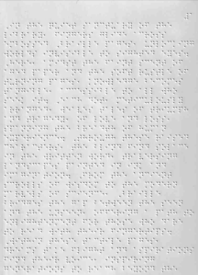
Cv2.imread
The method imread loads an image from the
specified file and returns it.

Slide 20
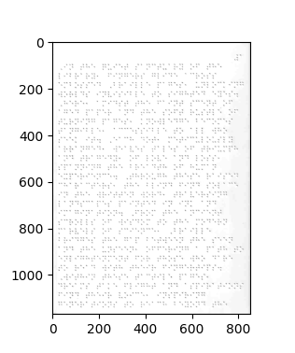
Cv2.convertScaleAbs
Scales, Calculate absolute values and convert the result to 8-bit using this equation.
dst(I) = saturate\ cast < uchar > (|src(I) ∗ alpha + beta|)

Slide 21
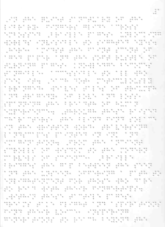
Cv2.GaussianBlur
Blurs an image using a Gaussian filter.
Critical parameter: Kernel size.
Benefits:
Noise Reduction
Edge Preservation
Preparation for Binarization
Reducing Artifacts

Slide 22
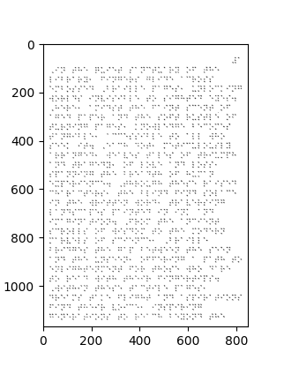
Cv2.threshold
The function is typically used to get a bi-level (binary) image out of a grayscale image.
THRESH_OTSU is utilized in our application combined with THRESH_BINARY to simplify the task of converting the image into a perfect black-and-white format

Slide 23
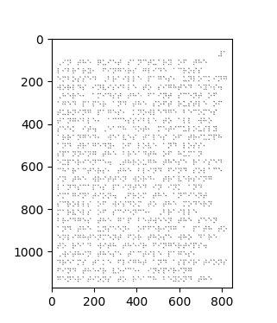
Cv2.threshold + Cv2.GaussianBlur
Reapply the GaussianBlur filter to further smooth the image, maximizing the effectiveness of this step.

Slide 24
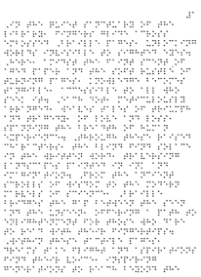
Cv2.adaptiveThreshold
The algorithm calculate the threshold for a small regions of the image. So, we get different thresholds for different regions of the same image, and it gives us better results for images with varying illumination.

Slide 25
Cv2.adaptiveThreshold
The challenging aspect of this filter lies in fine-tuning its parameters.
The key parameters are:
maxValue
blockSize
C (constant)

Slide 26

Cv2.medianBlur
MedianBlur is a powerful image processing filter that offers several benefits such as:
Noise Reduction
Edge Preservation
Detail Retention
While MedianBlur offers significant benefits, it also comes with challenges:
Computational intensity
Parameter tuning

Slide 27
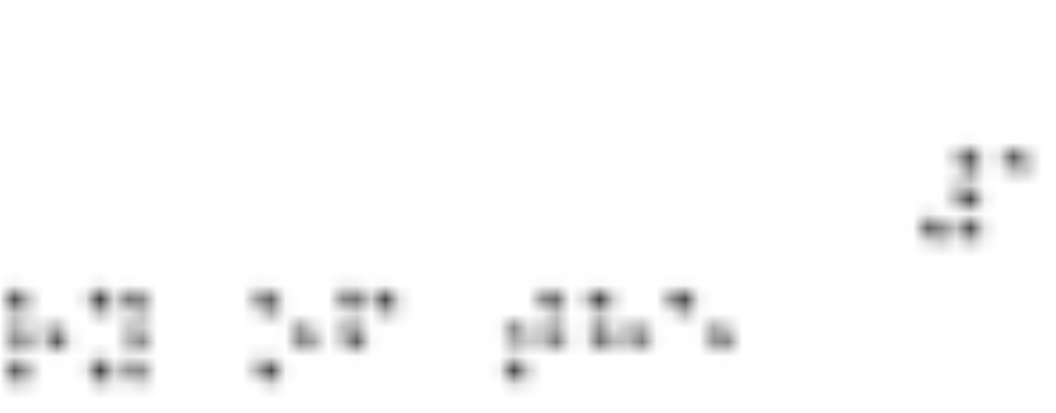

Cv2.adaptiveThresh+ Cv2.medianBlur
Before medianBlur
After medianBlur

Slide 28

Image Alignment and De-skewing
The next challenge in preprocessing is De-skewing rotated images.
This step is essential to enhance the accuracy of the next steps and to avoid over complicating the detection process.

Slide 29
Image Alignment and De-skewing:
The next challenge in preprocessing is De-skewing rotated images.
This step is essential to enhance the accuracy of the next steps and to avoid over complicating the detection process.

Slide 30
Image Alignment and De-skewing
The next challenge in preprocessing is De-skewing rotated images.
This step is essential to enhance the accuracy of the next steps and to avoid over complicating the detection process.
It is important to mention that the image must not be rotated with wide angles or else some of the dots will not scanned or partially scanned.
Two approaches tested: linear regression and Hough line transform

Slide 31
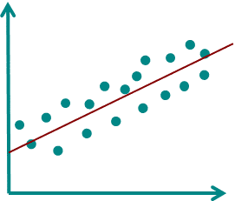
Linear Regression
We used Hough circle transformation to find the coordinates.
We tried to find the angle using the linear equation Y=BX+A. by calculating the slope of the straight line between two adjacent dots.
We couldn’t restrain the regression for the dots that should be at the same row.

Slide 32
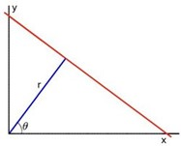
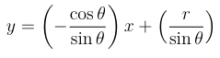
Hough Line Transform
A line in the image space can be expressed in two domains.
(a) The Cartesian domain: Parameters: (m, b).
(b) The Polar domain: Parameters: (r, θ).
Hough line transform utilize the polar domain so the lines equation would transformed
from
To

Slide 33
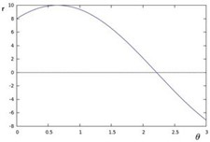
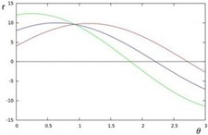
Hough Line Transform
The Utilization of polar domain results:
The transformation of a single dot in the cartesian domain into a sin curve in the (θ-r) plane.
The transformation of a single line in the cartesian domain into a point of intersection in the (θ-r) plane.
Hough transform uses the accumulation of the (θ-r) plane representing every dot, as the peaks of accumulation (intersections of curves) indicate the possible lines connecting these dots.

Slide 34
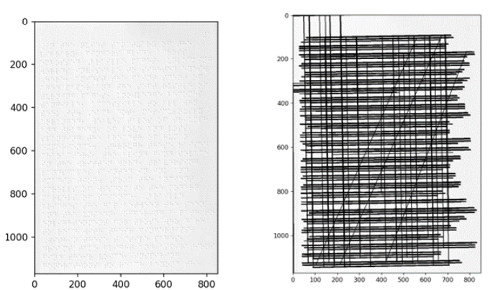
Steps of De-Skewing
Using Hough line probabilistic transform to detect lines on the Braille page
Eliminating lines with high rotation angle.
Converting vertical lines into horizontal lines.

Slide 35
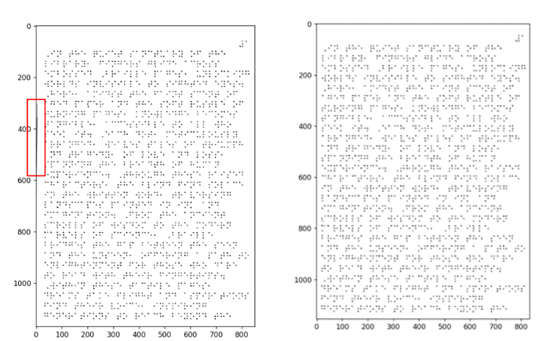
Steps of De-Skewing
Calculating the rotation angle and applying the De-skewing.
Refining padding resulting from rotation.
Cropping excess borders

Slide 36
Detection and Recognition Using Image Processing

Slide 37
Detection and Recognition Using Image Processing
01
02
Preprocessed Braille Page
Array Of Dots Locations
Array Of Symbols Mapped into Binary
Detection
Recognition
Edge Detection with Canny Edge Detector
Circle Detection with Hough Transform
Dots Alignment
A Challenge: Eliminating Unnecessary Extra Points
Predicting Potential Dot Locations
Identifying Braille Symbols and Mapping Braille Symbols into Binary

Slide 38
Edge Detection with Canny Edge Detector
Apply a Gaussian filter to smooth the image and reduce noise.
Calculate the intensity gradients of the image.
Use gradient magnitude thresholding or lower bound cut-off suppression to eliminate spurious edge detection responses.
Apply a double threshold to identify potential edges.
Use edge tracking by hysteresis to finalize edge detection by suppressing weak edges that are not connected to strong edges.

Slide 39
Edge Detection with Canny Edge Detector
(a) Original Image

Slide 40
Edge Detection with Canny Edge Detector
(b) Image after greyscale and noise reduction

Slide 41
Edge Detection with Canny Edge Detector
(c) After gradient calculation

Slide 42
Edge Detection with Canny Edge Detector
(d) After non-maximum suppression

Slide 43
Edge Detection with Canny Edge Detector
(e) Strong edges after double thresholding

Slide 44
Edge Detection with Canny Edge Detector
(f) Final edge tracking

Slide 45
Edge Detection with Canny Edge Detector: Braille Page
(a) Original Page (After Preprocessing)

Slide 46
Edge Detection with Canny Edge Detector: Braille Page
(b) Detected Edges

Slide 47
Edge Detection with Canny Algorithm: Braille Page
(a) Original Page (After Preprocessing)

Slide 48
Circle Detection with Hough Transform
Theory of Hough Circle Transform
3d parameter space.
Mathematically, a circle can be described by the equation: (x - x_{center})² + (y - y_{center})² = r²
For each edge point (x; y) in the image, the possible circles passing through that point are determined
Accumulator array in the parameter space is incremented.
The peaks in this accumulator array indicate the parameters of the circles present in the image.
Assume a constant radius

Slide 49
Circle Detection with Hough Transform
Theory of Hough Circle Transform
3d parameter space.
Mathematically, a circle can be described by the equation: (x - x_{center})² + (y - y_{center})² = r²
For each edge point (x; y) in the image, the possible circles passing through that point are determined
Accumulator array in the parameter space is incremented.
The peaks in this accumulator array indicate the parameters of the circles present in the image.
Assume a constant radius

Slide 50
Circle Detection with Hough Transform
Theory of Hough Circle Transform
3d parameter space.
Mathematically, a circle can be described by the equation: (x - x_{center})² + (y - y_{center})² = r²
For each edge point (x; y) in the image, the possible circles passing through that point are determined
Accumulator array in the parameter space is incremented.
The peaks in this accumulator array indicate the parameters of the circles present in the image.

Slide 51
Circle Detection with Hough Transform
Theory of Hough Circle Transform
3d parameter space.
Mathematically, a circle can be described by the equation: (x - x_{center})² + (y - y_{center})² = r²
For each edge point (x; y) in the image, the possible circles passing through that point are determined
Accumulator array in the parameter space is incremented.
The peaks in this accumulator array indicate the parameters of the circles present in the image.

Slide 52
Circle Detection with Hough Transform
Theory of Hough Circle Transform
3d parameter space.
Mathematically, a circle can be described by the equation: (x - x_{center})² + (y - y_{center})² = r²
For each edge point (x; y) in the image, the possible circles passing through that point are determined
Accumulator array in the parameter space is incremented.
The peaks in this accumulator array indicate the parameters of the circles present in the image.

Slide 53
Circle Detection with Hough Transform
Theory of Hough Circle Transform
3d parameter space.
Mathematically, a circle can be described by the equation: (x - x_{center})² + (y - y_{center})² = r²
For each edge point (x; y) in the image, the possible circles passing through that point are determined
Accumulator array in the parameter space is incremented.
The peaks in this accumulator array indicate the parameters of the circles present in the image.

Slide 54
Circle Detection with Hough Transform
Theory of Hough Circle Transform
3d parameter space.
Mathematically, a circle can be described by the equation: (x - x_{center})² + (y - y_{center})² = r²
For each edge point (x; y) in the image, the possible circles passing through that point are determined
Accumulator array in the parameter space is incremented.
The peaks in this accumulator array indicate the parameters of the circles present in the image.

Slide 55
Circle Detection with Hough Transform
Theory of Hough Circle Transform
3d parameter space.
Mathematically, a circle can be described by the equation: (x - x_{center})² + (y - y_{center})² = r²
For each edge point (x; y) in the image, the possible circles passing through that point are determined
Accumulator array in the parameter space is incremented.
The peaks in this accumulator array indicate the parameters of the circles present in the image.

Slide 56
Circle Detection with Hough Transform
Theory of Hough Circle Transform
3d parameter space.
Mathematically, a circle can be described by the equation: (x - x_{center})² + (y - y_{center})² = r²
For each edge point (x; y) in the image, the possible circles passing through that point are determined
Accumulator array in the parameter space is incremented.
The peaks in this accumulator array indicate the parameters of the circles present in the image.

Slide 57
Differences from Hough Gradient Method
The traditional Hough Circle Transform is computationally expensive: 3d space parameters
The Hough Gradient Method reduces the computational complexity by taking advantage of the gradients of edge points. Here’s how it works:
Edge Detection
Gradient Computation: For each edge point, the gradient direction is computed. The gradient direction indicates the direction of the center of the circle for that edge point.
Voting in Accumulator Space: The algorithm only votes for circle centers along the gradient direction

Slide 58
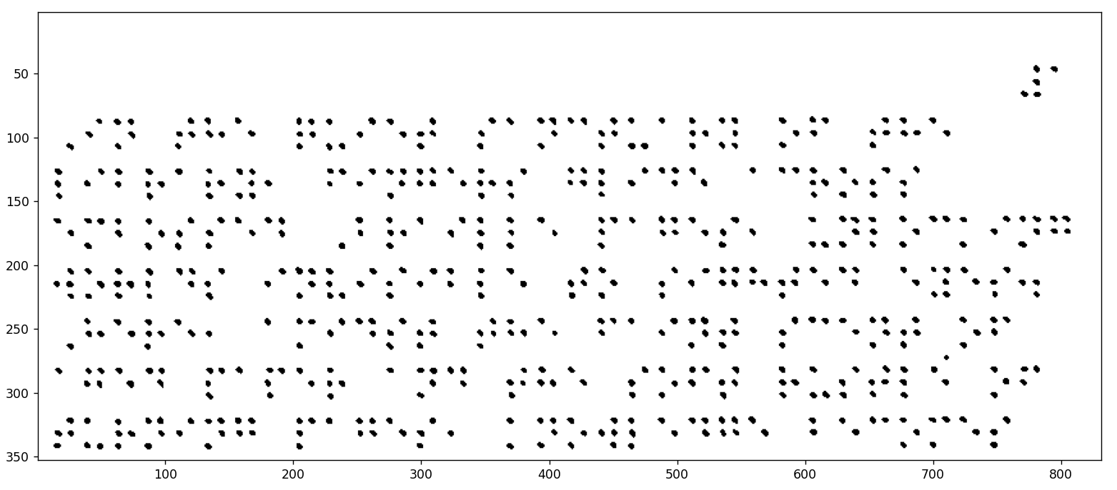
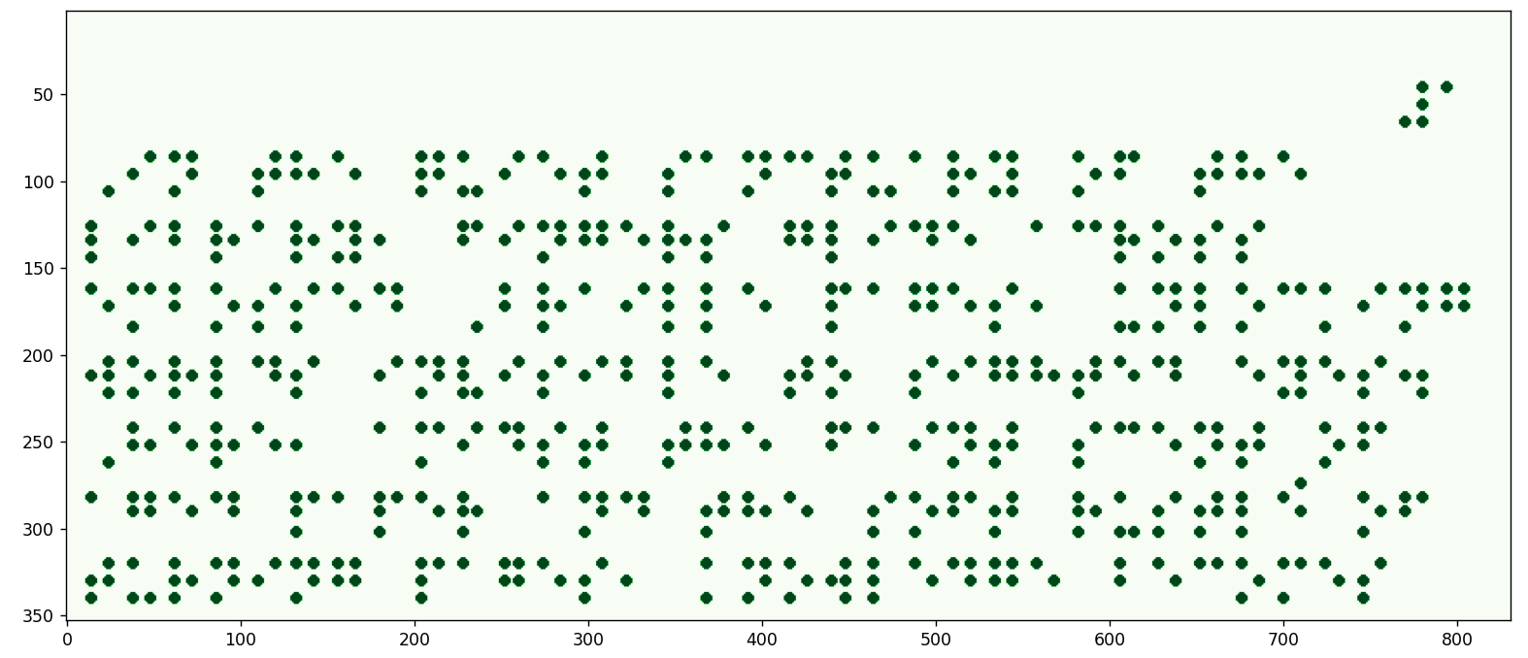
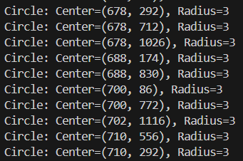
Original Preprocessed Page
Detected Dots (Drawn for illustration)

Slide 59
Original Preprocessed Page
Detected Dots (Drawn for illustration)

Slide 60
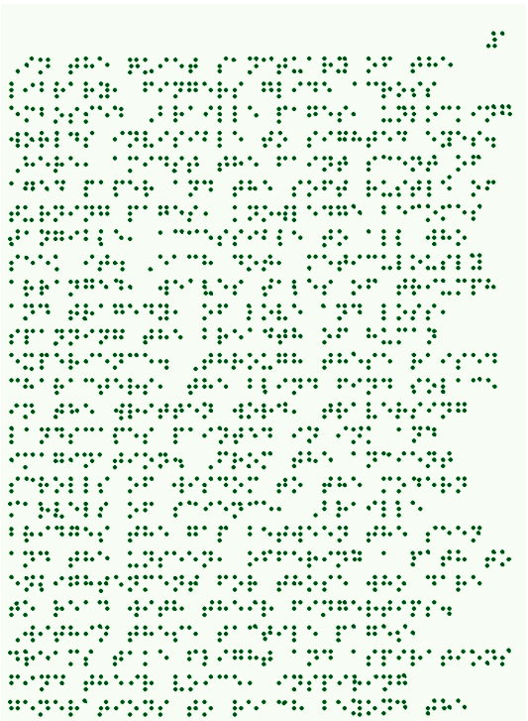
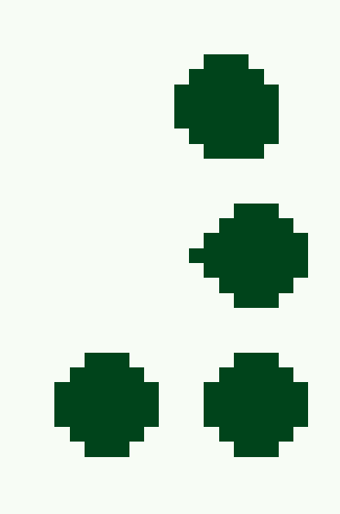
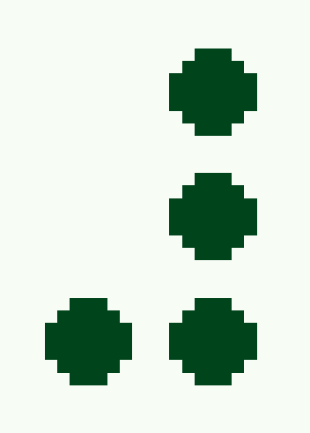
Identifying Braille Symbols
Dots Alignment
Before Alignment
Dots locations alignment:
The corresponding dots are aligned with the lower coordinate values

Slide 61
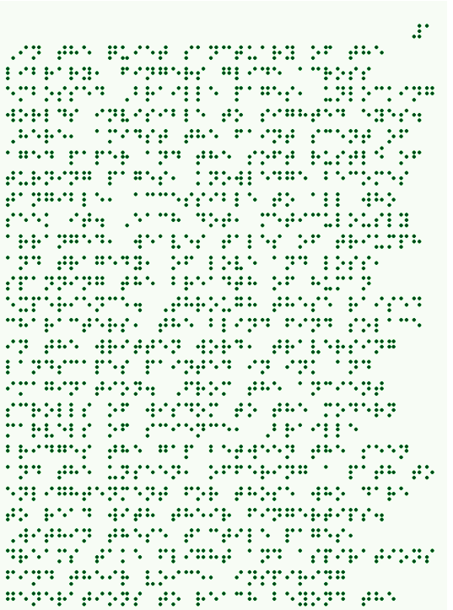
Identifying Braille Symbols
Dots Alignment
Before Alignment
Dots locations alignment:
The corresponding dots are aligned with the lower coordinate values

Slide 62
Identifying Braille Symbols
Dots Alignment
After Alignment
Dots locations alignment:
The corresponding dots are aligned with the lower coordinate values

Slide 63
Dots Alignment
After Alignment
Dots locations alignment:
The corresponding dots are aligned with the lower coordinate values

Slide 64
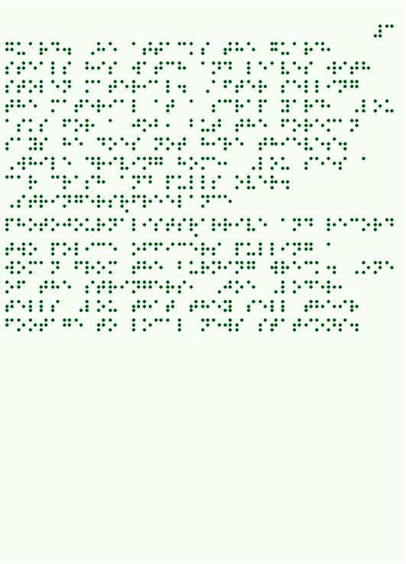
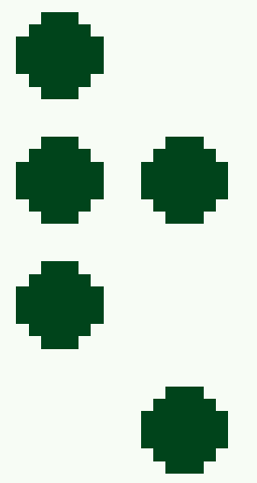
Identifying Braille Symbols
A Challenge: Eliminating Unnecessary Extra Points

Slide 65
Identifying Braille Symbols
A Challenge: Eliminating Unnecessary Extra Points

Slide 66
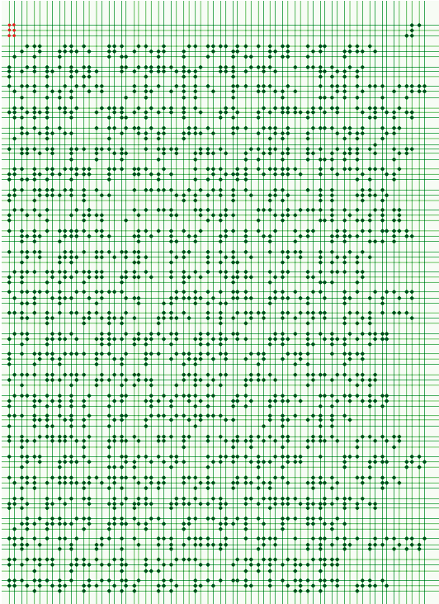
Recognition
Predicting Potential Dot Locations: Building a virtual grid
Assume each dot can be represented with an X-axis and a Y-axis passing through its center.
RED DOTS ARE JUST FOR ILLUSTRATION, THEY ARE NOT A PART OF THE ORIGINAL PAGE.

Slide 68
Recognition
Predicting Potential Dot Locations: Building a virtual grid
Assume each dot can be represented with an X-axis and a Y-axis passing through its center.
RED DOTS ARE JUST FOR ILLUSTRATION, THEY ARE NOT A PART OF THE ORIGINAL PAGE.
But! Page must be full of dots

Slide 69
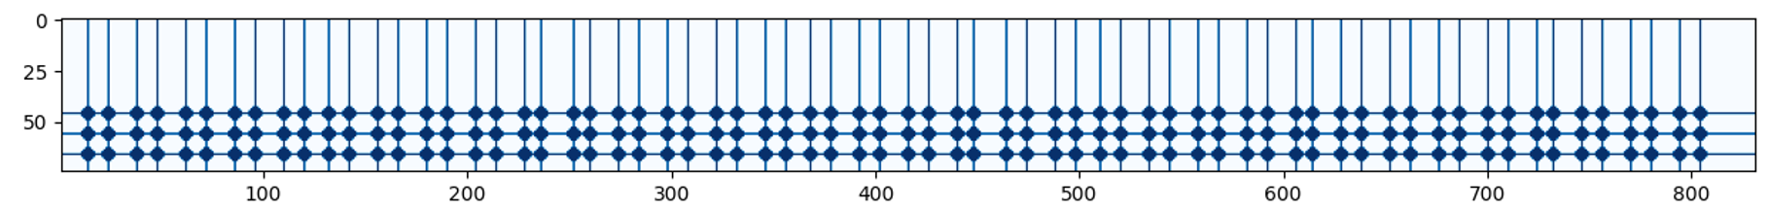

Recognition
General Matrix
Contains all the potential dot locations
RED DOTS ARE JUST FOR ILLUSTRATION, THEY ARE NOT A PART OF THE ORIGINAL PAGE.

Slide 70
Recognition
General Matrix
Contains all the potential dot locations
RED DOTS ARE JUST FOR ILLUSTRATION, THEY ARE NOT A PART OF THE ORIGINAL PAGE.

Slide 71
Recognition
Identifying Braille Symbols and Mapping Braille Symbols into Binary
Masking Process
RED DOTS ARE JUST FOR ILLUSTRATION, THEY ARE NOT A PART OF THE ORIGINAL PAGE.

Slide 73
Recognition
Mapping to binary:
1st row in binary:

Slide 74
Recognition
Mapping to binary:
1st row in binary:

Slide 75
Detection Using White Spaces

Slide 76








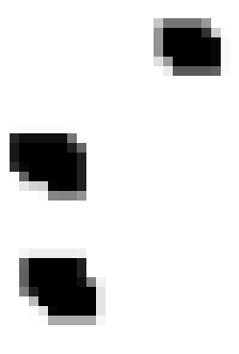





Detection Using White spaces
Preprocessed Braille Page
Individual Symbols

Slide 77
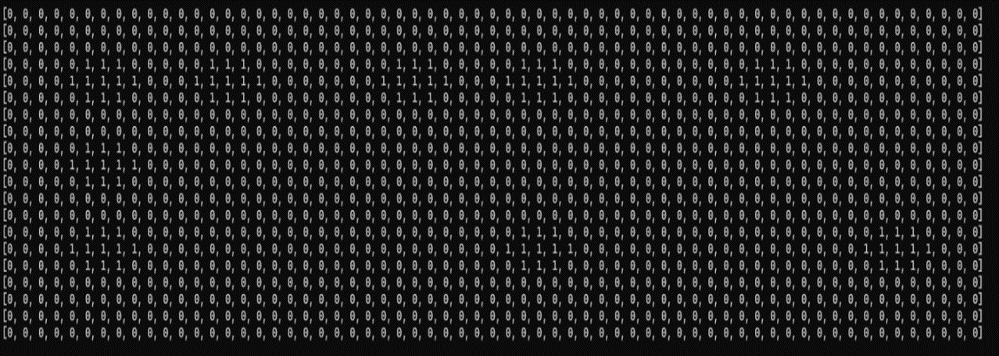
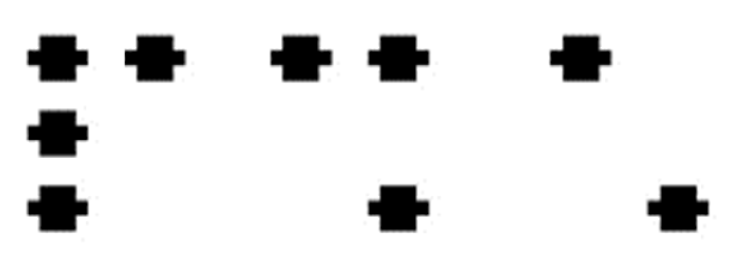
Turning the image into zeros and ones:

Slide 78
Turning the image into zeros and ones:

Slide 79
Determining the existence of black pixels

Slide 80
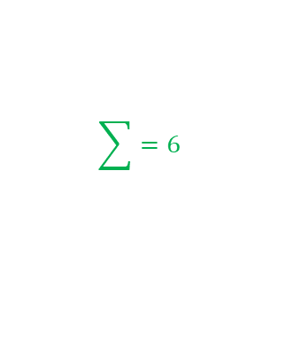

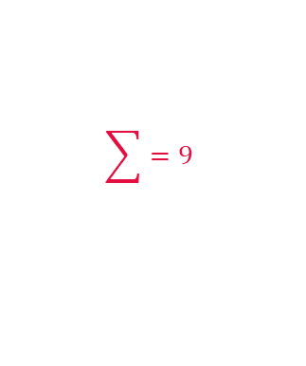

Determining the existence of black pixels
$$\sum{=0}$$
$$\sum{=9}$$
$$\sum{=0}$$
$$\sum{=6}$$

Slide 81
Deciding the candidate coordinates using threshold

Slide 82
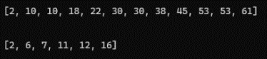
Deciding the candidate coordinates according to variance

Slide 83
Deciding the candidate coordinates according to variance

Slide 84
Deciding the candidate coordinates according to variance

Slide 85
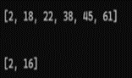
Extracting symbols coordinates

Slide 86

Extracting symbols coordinates

Slide 87
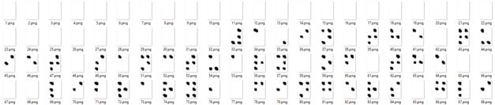
Dividing the page into symbol images
By iterating the we extracted from the previous step we iterate each symbol by the four coordinates that holds it, then the images are cropped and passed to the next stage of recognition in order.
The dividing was not efficient in case of rotated pages as the process of aligning changed the size of the dots which the threshold is calibrated on, resulting incorrect divisions for some lines, which lead to use of straightened pages only this approach.

Slide 88
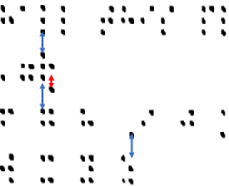
Problems and Challenges
Eliminating unnecessary points
there are some occasions where the user differentiate from the standard form of the Braille symbol and print the symbol with 4 rows instead of 3, which results in ruining the whole order of the coordinates as we work with only the standard form of 6 Braille dots.

Slide 89
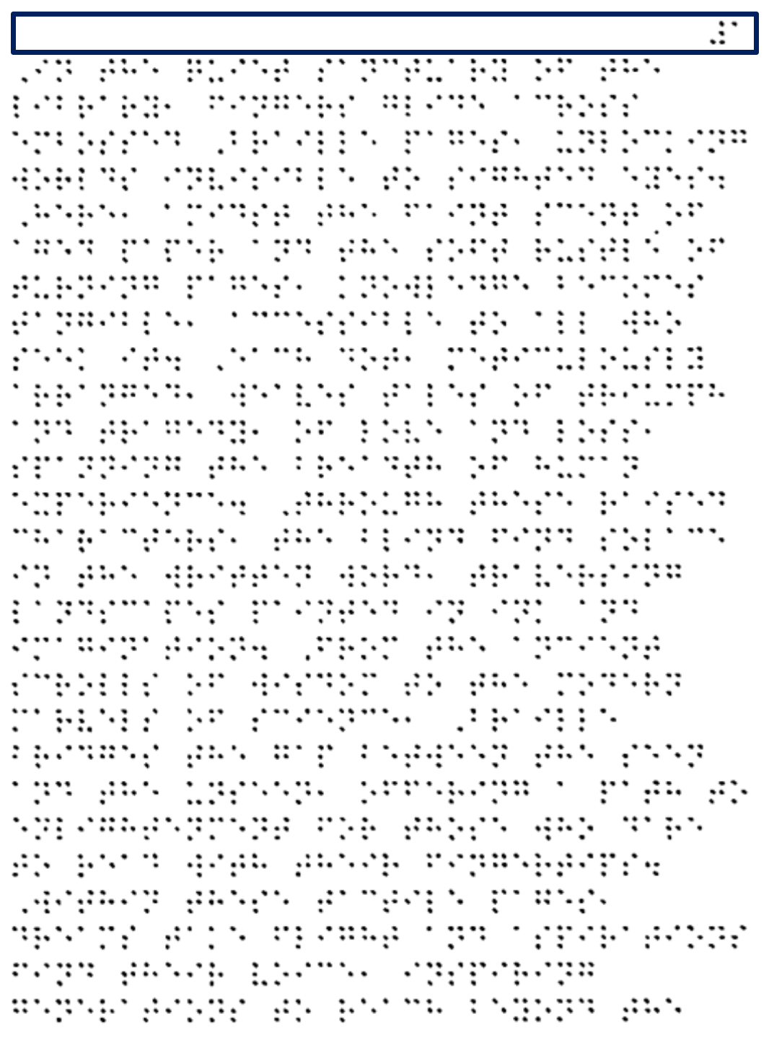
Problems and Challenges
Page number fading with threshold
This problem occur as the symbol of the number is always in a whole number of rows alone with no other symbols, so threshold that eliminate noise remove it. To solve this, we implemented dynamic threshold.

Slide 90
Recognition Using CNN

Slide 91
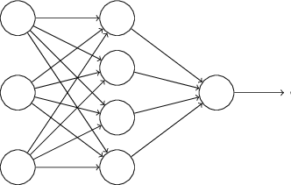
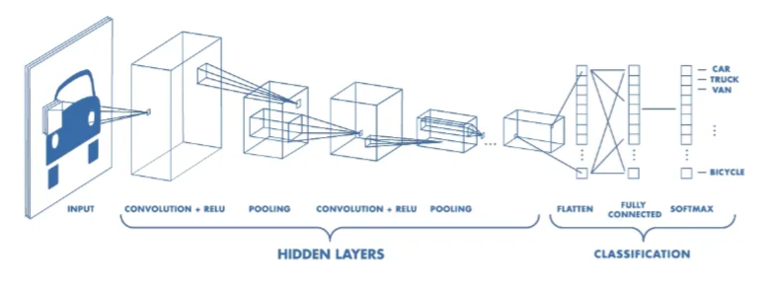
Convolutional Neural Network
-Convolution Layer -Pooling Layer
-Fully Connected Layer -Non-Linearity Layers

Slide 92
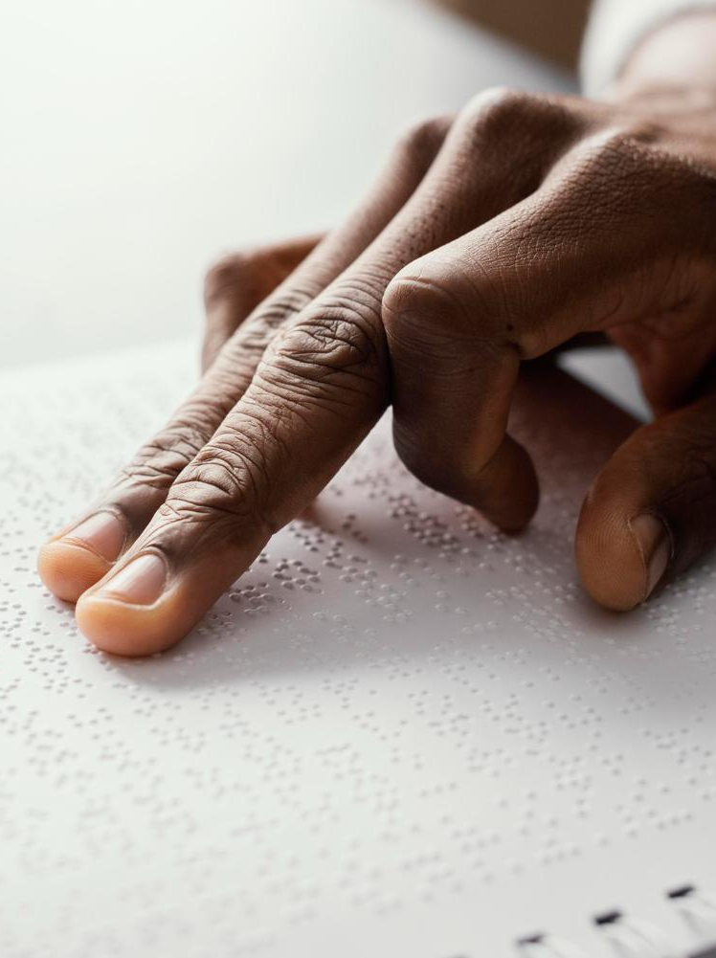
Datasets
In our project, we used two different datasets:
Kaggle dataset.
Our custom dataset.

Slide 93
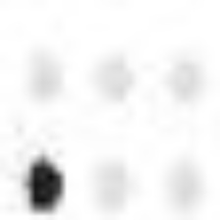

Kaggle dataset
It comprises images of 26 characters, each represented by 60 images of size 28x28 pixels.
The labels for the images are the letters from A to Z.
Problems:
The dataset does not cover all possible combinations.
Some images are rotated at large angles or flipped.
Symbols detected from an entire Braille-written page appear very different from the images in the dataset

Slide 94


Custom dataset
To generate this dataset, we used four pages and conducted two trials:
In the first trial, we used detection in image processing.
In the second trial, we used detection using white spaces.
Initially, the dataset was unbalanced , to address this we applied data augmentation techniques.
After augmentation, the dataset comprised 6519 images, with each symbol represented by about 100 images of size 224x224 pixels.

Slide 95
CNN Models
In our project, we used two different datasets:
Custom model.
DenseNet 201.

Slide 96
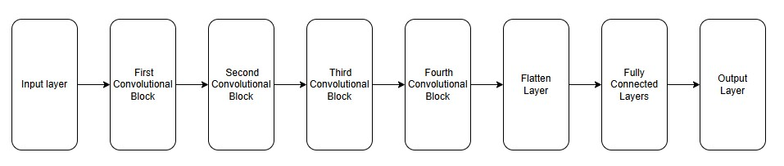
Custom CNN model
Model Architecture

Slide 97
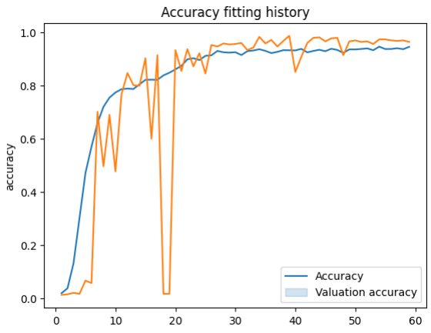
Model Accuracy
97%

Slide 98
Dense Net 201
Base model (DensNet 201):
Loading the DenseNet201 Model
Freezing Layers: All layers in the base model are initially frozen
Unfreezing the Last 40 Layers
Custom Layers:
Global Average Pooling
Fully Connected Layers (Dense Layer 1, Dropout Layer 1, Dense Layer 2, Dropout Layer 2 )
Output Layers

Slide 99
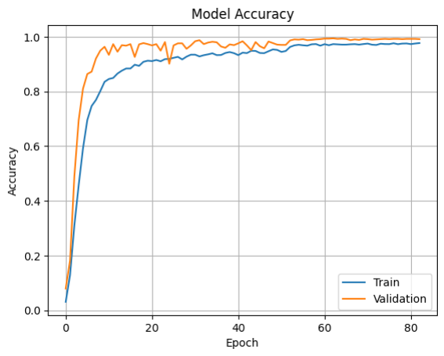
Model Accuracy
99%

Slide 100
Translation and Text Correction

Slide 101
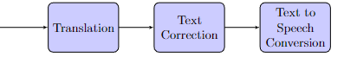
Introduction
Final Steps of Braille-to-English Text Conversion System:
- Further details in following slides.
Braille Page
Text Correction
Text to Speech
Translation

Slide 102
Data Encoding

Slide 103

Data Encoding
Braille converted to sequences of 0s and 1s. Why?
Raised dot = 1, flat dot = 0.
For example, the letter ‘a’ ( ) is encoded into ‘100000’.
A number is distinguished from a letter by a special character ( ) that precedes the Braille number.
‘a’ or ‘1’?

Slide 104

Deep Learning for Translation

Slide 105
Deep Learning for Translation
Deep Learning Model:
Type: DenseNet201 CNN.
Training: Trained on a dataset of 5215 Braille images.
Learning Process:
Learns features from the Braille dot patterns (e.g., position, number of raised dots).
Input: Organized Braille dots (Full Braille page).
Output: Translation of Braille; English text.

Slide 106
Mapping Braille to English Text
Character Mapping:
One-to-One Correspondence (Grade 1 Braille):
The system utilizes a pre-defined table linking each recognized Braille pattern (combination of raised dots) to its corresponding English character.
Character Order Preservation:
After translation, each identified Braille character is saved in a list, maintaining the exact order it appeared on the Braille page.

Slide 107
Integration and Output
Output Formatting
Enhances readability:
Removes unnecessary white spaces.
Formats paragraphs to match the original Braille document.
Text Assembly
Recognized characters transformed into sentences:
System loops through the saved character list.
Characters are assembled into words and sentences.
Preserves original structure

Slide 108

Text Correction

Slide 109
Text Correction
Post-translation errors: Spelling mistakes identified
Correction method: Contextual text correction.
Tools used:
Package: contextualSpellCheck
Pretrained model: T5-large-spell

Slide 110
History of BERT
BERT stands for Bidirectional Encoder Representations from Transformers.
It is a pre-trained natural language processing (NLP) model introduced by Google in 2018.
BERT is based on the Transformer architecture, which is a type of neural network architecture designed for sequence-to-sequence tasks.
BERT is known for its bidirectional training approach, allowing the model to consider context from both the left and right sides of a given word in a sentence.
It supports over 70 languages including Arabic.

Slide 111
How BERT Works - Intro
The goal of any given NLP technique is to understand human language as it is spoken naturally.
In BERT's case, this means predicting a word in a blank. To do this, models are trained using a large repository of specialized, labeled training data.
This process involves linguists doing manual data labeling.
BERT, was pretrained using only a collection of unlabeled, plain text, using the entirety of English Wikipedia and the Brown Corpus (about a million words.).
It continues to learn through unsupervised learning from unlabeled text and improves even as it's being used in practical applications such as Google search.

Slide 112
How BERT Works - Transformers
The transformer is the part of the model that gives BERT its increased capacity for understanding context.
The transformer processes any given word in relation to all other words in a sentence, rather than processing them one at a time like rule-based systems.
By looking at all surrounding words, the transformer enables BERT to understand the full context of the word and therefore better understand searcher intent.
The transformer used at BERT’s center is bidirectional.

Slide 113
How BERT Works - Self-Attention Mechanisms
BERT also relies on a self-attention mechanisms.
Self-attention mechanisms capture and understand relationships among words in a sentence.
This is significant because often, a word may change meaning as a sentence develops.
BERT accounts for the augmented meaning by reading bidirectionally, accounting for the effect of all other words in a sentence on the focus word and eliminating the left-to-right momentum that biases words towards a certain meaning as a sentence progresses.

Slide 114
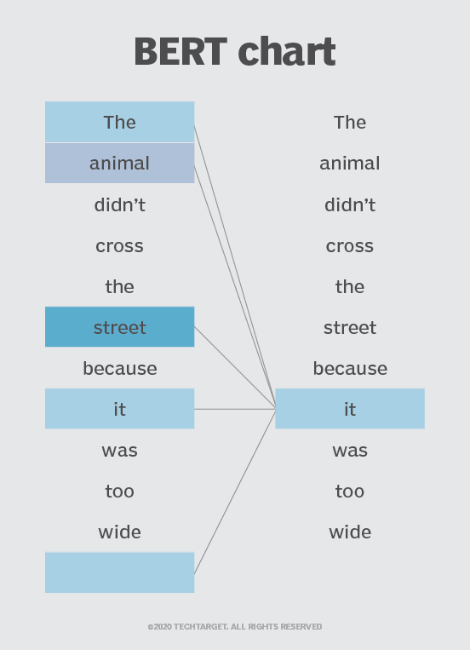
How BERT Works - Self-Attention Mechanisms
In the image, BERT is determining which prior word in the sentence the word "it" refers to, and then using the self-attention mechanism to weigh the options. The word with the highest calculated score is deemed the correct association. In this example, "it" refers to “street", not “animal". If this
phrase was a search query, the results would reflect this subtler, more precise understanding BERT reached.

Slide 115
Python’s ‘contextualSpellCheck’ Package
Based on BERT.
Package was tested on many test cases but its performance was not good.
It had two problems:
Not good at recognizing names.
Alters some words with other words.

Slide 116
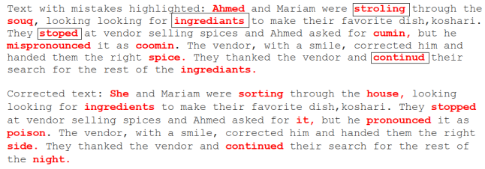
Python’s ‘contextualSpellCheck’ Package
-
Altering Names

Slide 117

Python’s ‘contextualSpellCheck’ Package
-
Replacing correct words with other words

Slide 118
The Pre-trained ‘T5-large-spell’ Model
Based on BERT.
Package was tested on many test cases and exhibited good performance in correcting wrong words.
It had two problems:
Requires a significant amount of time to correct sentences.
Model would add words to incomplete input sentences (those not ending with a full stop) in attempt to complete them.

Slide 119

The Pre-trained ‘T5-large-spell’ Model
-
Test Case

Slide 120

The Pre-trained ‘T5-large-spell’ Model
-
Model tries to complete sentences not ending in full stop

Slide 121
Text To Speech

Slide 122
Text To Speech
01
02
03
04
End-To-End
TTS Models
Tacotron
Conclusion
Why end to end systems?
A walk-through different AI models
Model architecture

Slide 123

Introduction
Text-to-Speech (TTS) technology converts written text into spoken words, playing a crucial role in our application to convert translated text into audio.
In the context of TTS technology, an end-to-end system encompasses all stages of text conversion to spoken output in one continuous process.

Slide 124

End-To-End
Advantages
Quality
Efficiency
High Quality Output
Easier to develop, test, and deploy
Consistency
Naturalness
Consistent approach, minimising errors
Produces lifelike speech output

Slide 125

Approaches & Models
CNN
NN
RNN
WaveNet
DeepVoice
Tacotron
A Generative Model for Raw Audio" (2016)
Real-time Neural Text-to-Speech (2017)
Towards End-to-End Speech Synthesis (2017)

Slide 126
RNN
Tacotron
Towards End-to-End Speech Synthesis (2017)
Why Tacotron?
Easier implementation
Minimal feature training required
Single loss function
Less computation power

Slide 127


Tacotron
Presented an end-to-end speech synthesis system that directly converts text to speech, eliminating the need for complex pre-processing and intermediate representations.
Simple
Disadvantage
Directly converts text to speech
Slightly less quality that can be tolerated

Slide 128

Architecture
Encoder
Attention Based Decoder
Reconstruction Algorithm
Featured CBHG unit

Slide 129
Encoder
Function: Converts input text into a sequence of continuous representations.
Process: The text is first embedded into vectors, which are then passed through a series of convolutional layers to capture local dependencies. These are followed by a bidirectional Long Short-Term Memory (LSTM) network to capture long-range dependencies and contextual information.

Slide 130
Decoder
Function: Generates a sequence of spectrogram frames from the encoded text representations.
Process: An attention mechanism is used to align the encoded text representations with the current decoding step. The decoder is typically an LSTM that produces spectrogram frames one step at a time, conditioned on the previous frames and the context provided by the attention mechanism.

Slide 131

Griffin-Lim
Initialization:
Start with an initial estimate of the complex spectrogram by combining the given magnitude spectrogram with a randomly initialized phase.

Slide 132
Griffin-Lim
Iteration:
Perform an inverse Fourier transform on the complex spectrogram to obtain the time-domain signal.
Compute the magnitude spectrogram of the resulting signal.
Multiply the original complex spectrogram by the ratio of the computed magnitude to the original magnitude. This step adjusts the phases of the complex values while preserving the magnitudes.
Repeat these steps for several iterations.

Slide 133
Griffin-Lim
Convergence:
The algorithm typically converges after a number of iterations, and the final reconstructed signal is obtained.

Slide 134
CBHG Unit
Function: Acts as a powerful feature extractor and sequence processor, used both in the encoder and the post-processing stage.
Structure:
Convolutional Bank: Applies multiple convolutional filters of different widths to capture various levels of detail from the input sequence.
Highway Network: Enhances the depth and complexity of the features extracted by allowing some information to pass through unchanged while transforming other parts.
Gated Recurrent Unit (GRU): Aggregates information over time, refining the sequence representations and ensuring temporal coherence.

Slide 135
CBHG Unit
Role:
In the encoder, the CBHG module processes the text embeddings to produce robust feature representations. In the post-processing stage, it refines the predicted spectrogram before conversion to waveform.

Slide 136
Conclusion
Tacotron’s performance is efficient without losing quality

Slide 137
Graphical User Interface

Slide 138

GUI
We designed a GUI for our application to facilitate communication between user and software.

Slide 139
Options to translate only one page or multiple pages.
Option to generate voice from previously translated text
Voice generation option

Slide 140

Browse to select image file to translate or an entire folder
Option to choose between image processing translation and AI
Option to return to previous page
Start Translation

Slide 141

Translated text display space
Options to open folder of saved text files or to translate another document

Slide 142
Results

Slide 143
Dot Detection using Hough Circle Transform
99.8%
19 errors
Accuracy of Dot Detections
10,212 dots were detected out of 10,231

Slide 144



Dot Detection using HCT
The example shown is the one with the most errors
9 undetected dots out of 2087.
This was a rotated image with angle -1.43 degrees

Slide 145

Image to text using Image process method
97.98%
20 mistakes out of 989
Accuracy from image to text
words including punctuation mistakes

Slide 146
CNN Model
99%
94.45%
Accuracy of individual symbol detection on test set
Overall all translating 21 wrong words out of 379

Slide 147

Text correction
The accuracy of the model used to correct the errors from the translated Braille characters is 100% of the errors we faced.

Slide 148
CNN model Translation speed
User | Text Generation (Second) | Text correction (Second) | Total time (Second)
HP ProBook | 180 | 150 | 330
Google Colab | 153 | 49 | 202
Kaggle | 130 | 38 | 168
Asus TUF F17 | 91 | 30 | 121

Slide 149

Summary
Image processing model showed faster and more accurate results in translating.
Both systems have the same output after the correction

Slide 150

Future work
Add Symbol Detection using AI models
Generalization of Image Processing
Enhancing AI Recognition Accuracy
& Optimizing Time
Handling Double-Sided Pages
& Translating different languages

Slide 151
Our Team
Abdallah Ashraf
Ayman Feteha
Ahmed Elsayed
Adham Mohamed
Nada Tarek
Ali
El-Neklawy
Nada
Gamal El-Dien

Slide 152

THANK YOU Any Questions?

